Slide 1
Introduction to OpenGL
Chun-Yuan Lin
CG
115/11/07

Slide 2
A basic library of functions is provided in OpenGL for specifying graphics primitives, attributes, geometric transformations, viewing transformations, and many other operations.
OpenGL is designed to be hardware independent, therefore many operations, such as input and output routines, are not included in the basic library. (auxiliary libraries that have been developed for OpenGL programs)
CG
115/11/07

Slide 3
Basic OpenGL Syntax (1)
Function names in the OpenGL basic library (OpenGL core library) are prefixed with gl, and each component word within a function name has its first letter capitalized.
glBegin, glClear, glCopyPixels, glPolygonMode
Certain functions require that one (or more) of their arguments be assigned a symbolic constant specifying. All such constants begin with the uppercase letter GL. In addition, component words within a constant name are written in capital letters, and the underscore (_).
GL_2D, GL_RGB, GL_CCW, GL_POLYGON, GL_AMBTENT_AND_DIFFUSE
CG
115/11/07

Slide 4
Basic OpenGL Syntax (2)
The OpenGL functions also except specific data types. Each data-type name begins with the capital letters GL and the reminder of the name is a standard data-type designation, written in lower-case letters.
GLbyte, GLshort, GLint, GLfloat, GLdouble, GLboolean
CG
115/11/07

Slide 5
Related Libraries (1)
In addition to the OpenGL basic libraries, there are a number of associated libraries for handling special operations.
The OpenGL Utility (GLU) provides routines for setting up viewing and projection matrices, describing complex objects with line and polygon approximations, displaying quadrics and B-splines using linear approximation, processing the surface-rendering operations, and other complex tasks. Each OpenGL implementation includes the GLU library and all GLU function names starts with the prefix glu.
CG
115/11/07

Slide 6
Related Libraries (2)
There is also an object-oriented toolkit based on OpenGL, called Open Inventor, which provides routines and predefined object shapes for interactive three-dimensional applications. (C++)
To create a graphics display using OpenGL, we first need to set up a display window on our video screen.
We can not create the display window directly with the basic OpenGL functions (device-independent)
CG
115/11/07

Slide 7
Related Libraries (3)
There are several window-system libraries that support OpenGL functions for a variety of machines.
  The OpenGL Extension to the X window System (GLX) provides a set of routines that are prefixed with the letter glx.
  Apple systems can use the Apple GL (AGL) interface for windows- management operations. Function names for this library are prefixed with agl.
  For Microsoft Windows systems, the WGL routines provides a Windows-to-OpenGL interface. These routines are prefixed with the letter wgl.
  The Presentation Manager to OpenGL (PGL) is an interface for the IBM OS/2, which uses the prefix pgl for the library routines.
  The OpenGL Utility Toolkit (GLUT) provides a library of functions for interacting with any screen-windowing system. The GLUT library functions are prefixed with glut.
CG
115/11/07

Slide 8
Related Libraries (4)
GLUT library also contains methods for describing and rendering quadric curves and surfaces.
Since GLUT is an interface to other device specific windows systems, we can use GLUT. (device-independent)
http://www.opengl.org/resources/libraries/glut/
CG
115/11/07

Slide 9
Header Files (1)
In all of our graphics programs, we will need to include the header file for the OpenGL core library.
For most applications we will also need GLU.
And we need to include the header file for the window system. For WGL, windows.h header file must be listed before the OpenGL and GLU header files.
#include <windows.h>
#include <GL/gl.h>
#include <GL/glu.h>
CG
115/11/07

Slide 10
Header Files (2)
However, if we use GLUT to handle the window managing operations, we do not need to include gl.h and glu.h.
#include <GL/glut.h>
In addition, we will often need to include header files that are required by the C code.
#include <stdio.h>
#include <stdlib.h>
#include <math.h>
#include <time.h>
CG
115/11/07

Slide 11
Display-Window Management
Using GLUT (1)
To get started, we can consider a simplified, minimal number of operations for display a picture. Since we are using the GLUT, the first step is to initialize GLUT.
glutInit (&argc, argv);
Next, we can state that a display windows is to be created on the screen with a given caption for the title bar.
glutCreateWindow (“An Example OpenGL Program”);
CG
115/11/07

Slide 12
Display-Window Management
Using GLUT (2)
Then we need to specify what the display window is to contain. For this, we create a picture using OpenGL functions and pass the picture definition to the GLUT routine glutDisplayFunc, which assigns our picture to the display window.
glutDisplayFunc (lineSegment);
* suppose we have the OpenGL code for describing a line segment in procedure called lineSegment.
But the display windows is not yet on the screen. We need one more GLUT function to complete the window-processing operations.
glutMainLoop ();
CG
115/11/07

Slide 13
Display-Window Management
Using GLUT (3)
glutMainLoop function must be the last one in the program. It display the initial graphics and puts the program into an infinite loop that checks for input from devices such as a mouse or keyboard.
Although the display window that we created will be in some default location and size, we can set these parameters using additional GLUT functions.
We use the glutInitWindowPosition function to give an initial location for the top-left corner of the display window. This position is specified in integer screen coordinates, whose origin is at the upper-left corner of the screen.
glutInitWindowPosition (50, 100);
CG
115/11/07

Slide 14
Display-Window Management
Using GLUT (4)
Similarly, the glutInitWindowSize function is used to set the initial pixel width and height of the display window.
glutInitWindowSize (400, 300);
We can also set a number of other options for the display windows, such as buffering and a choice of color modes, with the glutInitDisplayMode function.
glutInitDisplayMode (GLUT_SINGLE | GLUT_RGB);
The values of the constants passed to this function are combined using a logical or operation. (single buffering and RGB, default)
CG
115/11/07

Slide 15
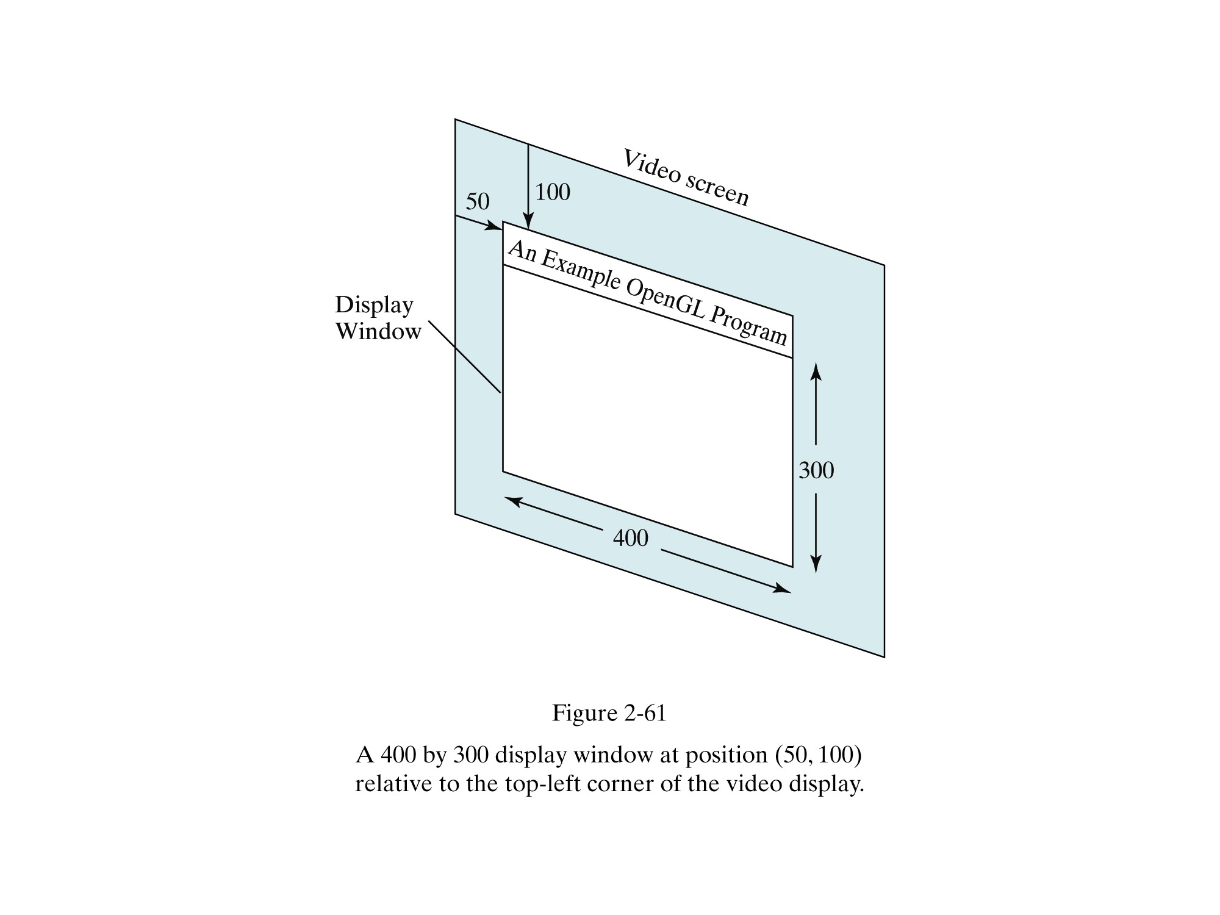

Slide 16
A Complete OpenGL Program (1)
There are still a few more tasks to perform before we have all the parts we need for a complete program.
For the display window, we can choose a background color. We need to construct a procedure that contains the appropriate OpenGL functions for the picture that we want to display.
glClearColor (1.0, 1.0, 1.0, 0.0);
The first three arguments in this function set each of the red, green, and blue component colors to the value 1.0. The fourth parameter in the glClearColor function is called the alpha value.
CG
115/11/07

Slide 17
A Complete OpenGL Program (2)
Although the glClearColor command assigns a color to the display window, it does not put the display window on the screen. To get the assigned window color displayed, we need to invoke the following OpenGL function.
glClear (GL_COLOR_BUFFER_BIT);
The argument GL_COLOR_BUFFER_BIT is an OpenGL symbolic constant specifying that it is the bit values in the color buffer that are to be set to the values indicated in the glClearColor function.
CG
115/11/07

Slide 18
A Complete OpenGL Program (3)
In addition to setting the background color for the display window, we can choose a variety of color schemes for the objects we want to display in a screen.
glColor3f (1.0, 0.0, 0.0);
The suffix 3f on the glColor function indicates that we are specifying the three RGB color components using floating-point (f) value.
We simply display a two-dimensional line segment. We want to project our picture onto the display window, because generating a two-dimensional picture is treated by OpenGL as a special case of three-dimensional viewing.
CG
115/11/07

Slide 19
A Complete OpenGL Program (4)
glMatrixMode (GL_PROJECTION);
gluOrtho2D (0.0, 200.0, 0.0, 150.0);
This specifies that an orthogonal projection is to be used to map the contents of a two-dimensional (2D) rectangular area of world coordinates to the screen, and that the x-coordinate values within this rectangle range from 0.0 to 200.0 with y-coordinate values ranging from 0.0 to 150.0.
Finally, we need to call the appropriate OpenGL routines to create our line segment.
CG
115/11/07

Slide 20
A Complete OpenGL Program (5)
glBegin (GL_LINES);
glVertex2i (180, 15);
glVertex2i (10, 145);
glEnd ();
The code defines a two-dimensional, straight-line segment with integer Cartesian endpoint coordinates (180, 15) and (10, 145).
glFlush forces all buffers to be emptied and the OpenGL function to be processed.
CG
115/11/07

Slide 21
#include<stdlib.h>
#include<stdio.h>
#include<time.h>
#include<GL/glut.h> // (or others, depending on the system in use) void init (void)
{ glClearColor (1.0, 1.0, 1.0, 0.0); // Set display-window color to white. glMatrixMode (GL_PROJECTION); // Set projection parameters. gluOrtho2D (0.0, 100.0, 0.0, 150.0);
} void lineSegment (void)
{ glClear (GL_COLOR_BUFFER_BIT); // Clear display window. glColor3f (1.0, 0.0, 0.0); // Set line segment color to red. glBegin (GL_LINES); glVertex2i (180, 15); // Specify line-segment geometry. glVertex2i (10, 145); glEnd ( ); glFlush ( ); // Process all OpenGL routines as quickly as possible.
}
CG
115/11/07

Slide 22
int main (int argc, char** argv)
{ glutInit (&argc, argv); // Initialize GLUT. glutInitDisplayMode (GLUT_SINGLE | GLUT_RGB); // Set display mode. glutInitWindowPosition (50, 100); // Set top-left display-window position. glutInitWindowSize (400, 300); // Set display-window width and height. glutCreateWindow ("CYLIN's OpenGL Program"); // Create display window. init ( ); // Execute initialization procedure. glutDisplayFunc (lineSegment); // Send graphics to display window. glutMainLoop ( ); // Display everything and wait.
}
CG
115/11/07

